Slide 1
Android Security VS. IOS security
CNIT581
Snow Zhou
Dec 10, 2014

Slide 2
Topic introduction
IOS and Android take the mainstream at today’s mobile market. The competition between IOS and Android becomes fierce due to the increasing amount of users. In the perspective of users, they are willing to understand the advantages and disadvantages of mobile systems in order to make a wise purchase. IOS and Android system have been launched into market for many years. The development procedures of the two systems are supposed to be mature. However it doesn’t indicate that IOS and Android are approaching to perfect. The security issue of mobile systems still exists, which is the reason why the two systems are being updated and improved.
The purpose the research is to provide users a guideline about the characteristics of IOS and Android when they are going to purchase a mobile device. Especially when they are hesitating between IOS and Android.

Slide 3
Research questions
In the aspect of security and flexibility, which mobile operating system is more superior? IOS or Android?
How should we measure a mobile operating system is secure or not?
Why we need to consider the mobile operating system issue?
We do not consider jailbroken device so far since the jailbroken user has already given up the system’s security.

Slide 4
Literature review
Android grew to a very large number: 87%. This was its share of the global smartphone market. It also grew to an even larger one: 97%. This was Android’s share of global mobile malware (Forbes, 2013).At July of 2014, the Kaspersky Lab published the statistic of malware distribution on different mobile operating system. They began to collect data on the attacks against Android users and the increase of malwares targeted to Android. About 500,000 users have encountered mobile malware designed to steal money at least once. The number of modifications for mobile Trojans increased 14 times over 12 months, from a few hundred to more than 5000 (Kaspersky Lab, 2014). With the increase of Android market, the attackers find more opportunities to perform attacks (Petrovan, 2013). Analyzing malware discovered during the first quarter of the year, F-Secure found that Android was targeted by 275 out of 277 "threat families." In contrast, iOS and Symbian each accounted for one a piece (Whitney, 2014). The security of iOS has been propagated since iOS is launched to the mobile market (Prince, 2014). However due to the lack verification of applications, iOS security is also criticized recently (Clover, 2014). The malwares attacking on iOS exist. Security research of Fortinet blog has provided a list of iOS malwares. We learn that most of malwares only worked on jailbroken devices (Apvrille, 2014). However three of them still work on normal devices, which throw an alert to iOS users that their devices might not achieve the expected secure level (Kovacs, 2014).

Slide 5
Methodology data collection & analysis
iOS Malware
Name Discovered data Application Type
iOS/Toires.A!tr.spy Nov 2009 SpyPhone Rogue-Proof of Concept
Adware/LBTM!iOS Sep 2010 LBTM Call premium number
iOS/FindCall.A!tr.spy July 2012 Find and Call Privacy Trojan
Normal vs. Jailbroken
Trapsms
MobileSpy
Eeki.A!worm iOS/Toires.spy
Eeki.B!worm + Adware
KeyGuard FindCall.spy
Riskware
AdThief
SSLCreds
Jailbroken malwares
73+27%
iOS/Toires.spy
Adware
FindCall.spy
Malwares worked on any
27%

Slide 6
Methodology data collection & analysis
Technically iOS constrains the installation for some programs. Users can only download and install applications from the official store provided by Apple. Additionally, all applications installed on iOS were examined and verified by the official institution so that the malicious applications could be filtered out. However under pressure from massive amount of customers and competitors, iOS becomes more open while it cannot guarantee one hundred percent security. The mistake could appear during the verification procedure for applications.

Slide 7
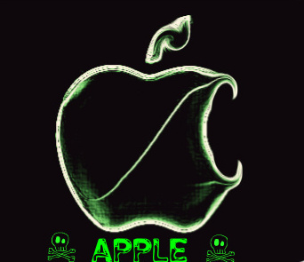
Malwares targeted to iOS
Malwares targeted to iOS do exist. Most of malware only works on jailbroken devices. However 27% of malwares can impact the iOS normal devices. Adware/LBTM!iOS used to be found at official AppStore. The malware has been removed from AppStore for a long time. Generally iOS malwares are more likely to target on jailbroken devices. Users who do not gain root access are less likely to be attacked.
Malware performance on iOS 2010-2014
Generate hill bills by calling premium number
Keylogger that eavesdrops on all pressed keys
Trojan that steals contact lists including email address, phone number and name
Spyware
Hijacks advertisement revenue
Password cracker

Slide 8
Malwares targeted to android
Millions of Units
Years
Although Android devices are supported by the official Google store, there are still some applications from third party stores that have the potential to damage the system integrity. To be more specific, Android users undertake the risk of being infected by malware. Some applications from third party stores have a higher security level, such as Amazon store. However many applications from third party stores will not be verified.

Slide 9
Malwares targeted to android
Malware performance on Android devices 2010-2014
Gain root or convince the user to root his phone
Sending paid or malicious SMS messages
Stealing location information
Information stealing to a remote server
Installing other applications or binaries, potentially unwanted application ("Hacker"-Tools),
Banking Trojan
Infect a connected Windows PC with a Trojan

Slide 10
Mobile Malwares distribution
Why Android device is so vulnerable?
Users do not need any authorization to open the developer mode to gain access to the operating system such as read and write files or install untested programs, etc. If a system supports any program written by users, the security level should be doubted.
Applications from third party stores lack official verification.
Users do not have enough technical knowledge and skills so that the misoperation might cause damage to their devices.
The amount of user is increasing rapidly. Thus the amount of hacker is increasing at same time.

Slide 11
iOS users vs. android users
iOS users vs. Android users 2014 Shipment
OS Platform Unit(million)
Android 997.7
iOS 184.1
Windows Phone 43.3
BlackBerry 9.7
Others 9.3
Total 1244.1

Slide 12
Choice between iOS and android
General users without enough technical knowledge are advised to try iOS. We can assume most users are looking for the system platform that is functional enough for life. Users worry about the system security and the confidentiality of sensitive information. Lack of technical knowledge can possibly result in personal loss. Therefore in the aspect of security, iOS is superior to Android.
Users with professional technology and computer knowledge are advised to use Android systems because they are able to protect credential information and system security. The flexibility of Android could be an added bonus because users could technically interact with their device

Slide 13
conclusion
iOS and Android are brilliant mobile systems despite the flaw of security. They make great contributions to modern technology and society. Mobile markets would suffer rapidly without Android and iOS. Users should understand that there is no absolute security in mobile operating systems. Even mobile manufacturers cannot define what is the most secure system.

Slide 14
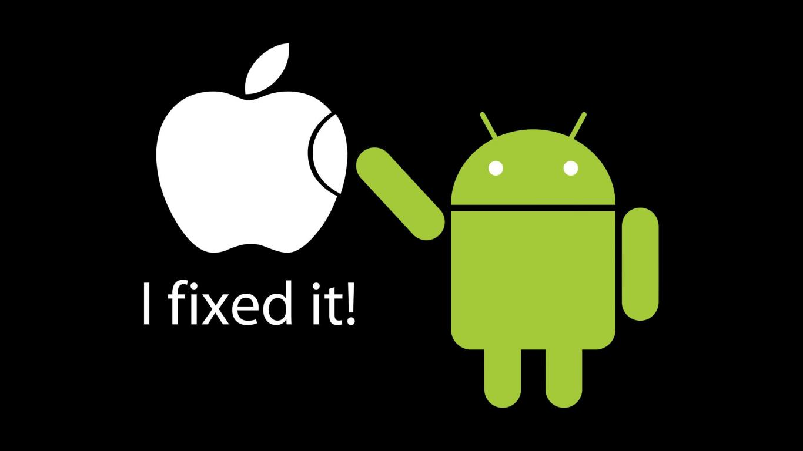
conclusion
With the trend that mobile users pick a team and cannot change their choice anymore because of the incompatibility in eco-system of the two systems, a comparison and analysis of iOS and Android should be made early.
iOS is more secure. Android is more flexible. But, they are not mutual assistant. Users are not recommended to pick both of them at same time. The ecosystem of iOS and Android are exclusive to each other. If the data cannot be synchronized, the utility of the device will fall down.

Slide 15
reference
Apvrille, A. (2014). Security Research: Threat Landscape and Analysis. iOS Malware Does Exist.
Bolluyt, J.(2014). The CheatSheet. Android vs. iOS: How We Are the Biggest Difference. Retrieved from http://wallstcheatsheet.com/technology/apple/android-vs-ios-how-users-are-the-biggest-difference.html/?a=viewall.
Cheng, J. (2012). The Apple ecosystem. “Find and Call” app becomes first Trojan to appear on iOS App Store. Retrieved from http://arstechnica.com/apple/2012/07/find-and-call-app-becomes-first-trojan-to-appear-on-ios-app-store/
Current Android Malware. (2014). Forensic blog: mobile phone forensics and mobile malware. Retreived from http://forensics.spreitzenbarth.de/android-malware/.
Edwards, J. (2014, May 31). The iPhone 6 Had Better Be Amazing And Cheap, Because Apple Is Losing The War To Android. Business Intelligence Market. Retrieved from http://www.businessinsider.com/iphone-v-android-market-share-2014-5.
Greenberg, A. (2014). Forbes. Android Upgrades Open A Backdoor To Malware, Researchers Show.

Slide 16
reference
Kessler, T. (2014). Maclssues. How to protect yourself from ‘Masque Attacks’ that replace iOS apps with malware. Retrieved from http://www.macissues.com/2014/11/10/how-to-protect-yourself-from-masque-attacks-that-replace-ios-apps-with-malware/.
Maslennikov, D. (2012). The SecureList. Find and Call: Spam and List. Retreived from http://securelist.com/blog/incidents/33544/find-and-call-leak-and-spam-57/
Nash, T. (2005). An Undirected Attack Against Critical Infrastructure: A Case Study for Improving Your Control System Security.
Reid, B. (2014). iOS Backdoor Loopholes Let Apple And Government Agencies Collect Private Data. Retrieved from http://www.redmondpie.com/ios-backdoor-loopholes-let-apple-and-government-agencies-collect-private-data/.
Xiao, C. (2014). WireLurker: A New Era in OS X and iOS Malware.

